Slide 1

React
Deployment

Slide 2
# Table of Contents
Refactor State Redux
Deployment

Slide 3
Refactor

Slide 4
# Redux State Movies
Previously all pages use redux state local (movies)
Create reducer to update redux state
To use movies from API
Referensi: Redux Toolkit - Create Slice.

Slide 5
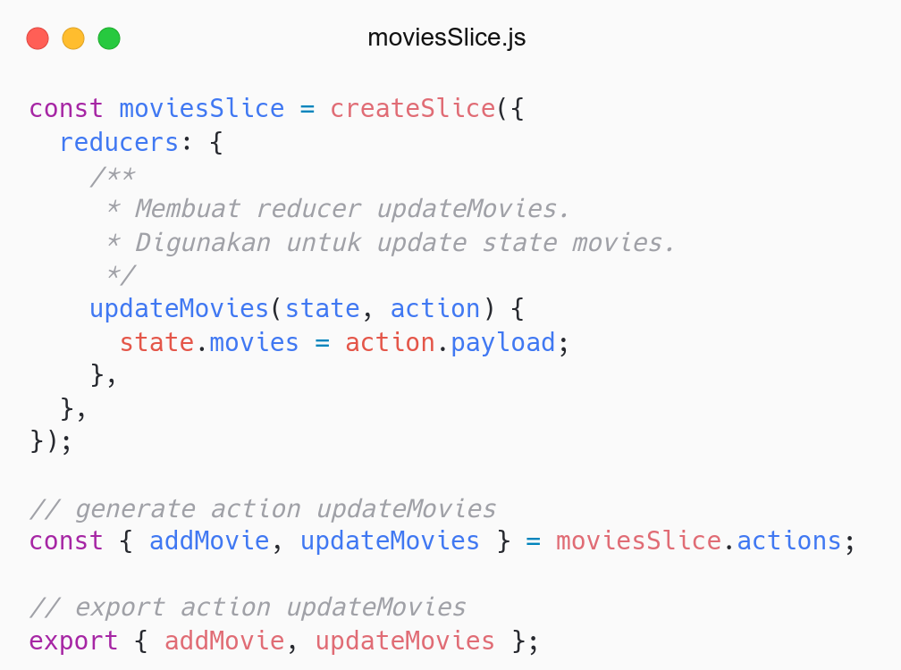
Membuat reducer updateMovies.
Digunakan untuk update state movies.
Generate action updateMovies.

Slide 6
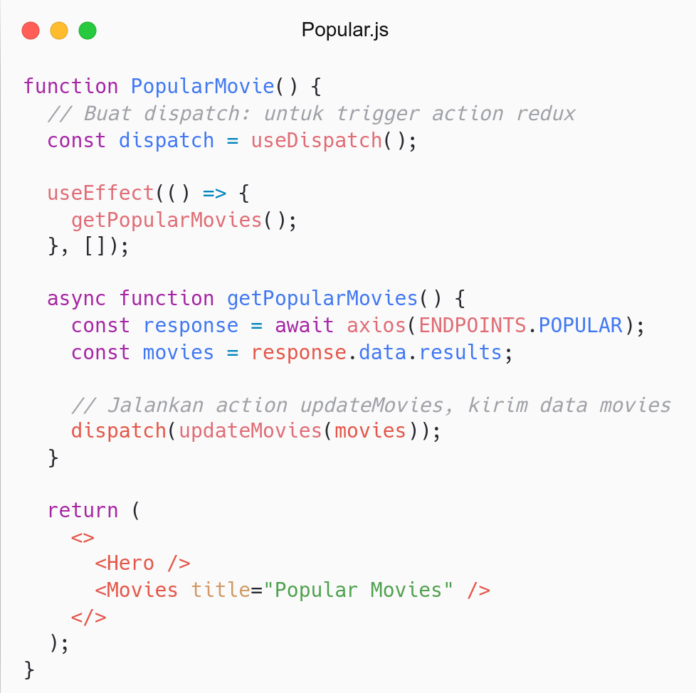
Buat dispatch: untuk trigger action.
Jalankan action updateMovies.
No need movies state.
Update in other pages: Detail, NowPlaying, TopRated.
Another approaches: RTK Query.

Slide 7
Deployment

Slide 8
# Terms
Development: Aplikasi dalam tahap pengembangan.
Production: Aplikasi dalam tahap produksi (publish).
Deployment: Proses publish aplikasi ke tahap Production.

Slide 9
# Deployment
Sebelumnya aplikasi berjalan di tahapan Development.
Generate aplikasi untuk digunakan di tahapan Production.
Perintah: npm run build.
Menghasilkan folder build.
Berisi static file: html, js.

Slide 10
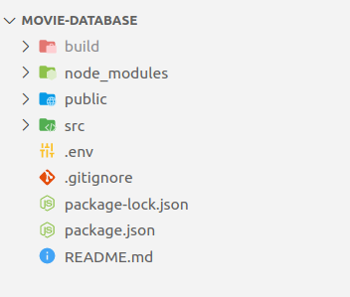
Jalankan npm run build.
Menghasilkan folder build.
Digunakan untuk tahapan production.

Slide 11
# Setup Server
Folder build tidak bisa langsung dijalankan.
Setup Server to run locally.
Solution: Static Server, Express
Install static server: npm i -g serve.
Referensi: Create React App - Static Server.

Slide 12
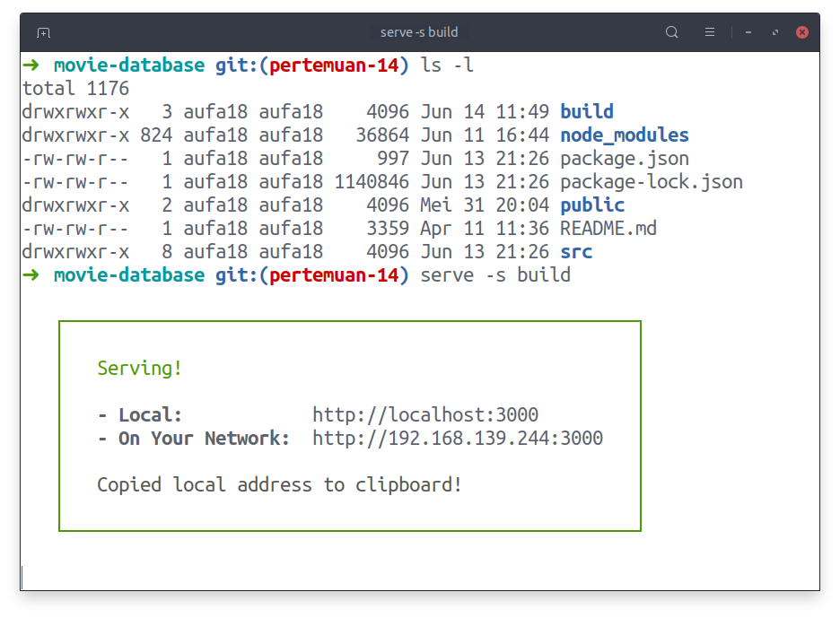
Menjalankan folder build di local.
Jalankan perintah: serve -s build.
Akses localhost:3000.

Slide 13
# Pre-Deployment
Fix errors and warnings in console.
Remove console.log.
Push to repository github.
Merge to main branch.

Slide 14
# Vercel
Platform to host frontend application.
Zero configuration.
Creator of Next (Framework React).
Support most of frontend framework
Register (by Github): Link.
Referensi: Vercel - Homepage.

Slide 15
# Vercel - Deployment
Click New Project button
Import Git Repository: Movie Database.
Configure Project and Set Environment Variable
Click Deploy and Voila.
Referensi: Create React App - Deployment Vercel.

Slide 16
# Github Pages - Deployment
Add homepage to package.json: https://username.github.io/nama-repo
Install gh-pages: npm i gh-pages --save
Add deploy script:
predeploy: npm run build.
deploy: gh-pages -d build
Jalankan deploy: npm run deploy
Set Pages to use github-pages branch: Link.
Referensi: Create React App - Deployment Github Pages.

Slide 17
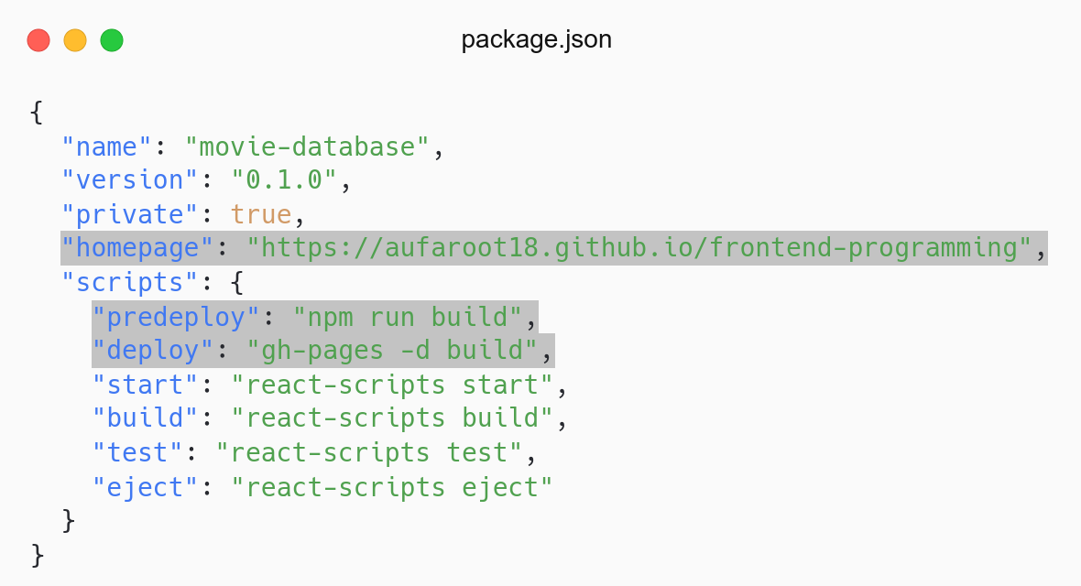
Tambahkan property homepage.
Tambahkan script predeploy dan deploy.
Jalankan deploy: npm run deploy.

Slide 18
# Github Pages - Bugs
Try to access other pages.
There is a bug in routing.
Because the root project is username.github.io not username.github.io/repo.
Solution: Change BrowserRouter to HashRouter
Deploy again.

Slide 19
Improvement

Slide 20
# Improvement
Build UI Component or Design System: Freecodecamp - Create Design System.
Add Animation: Framer Motion.
Add loading state.
Save movies to local storage: JavaScript Info - Localstorage.
Much more, try to improve by yourself.

Slide 21
Recap Journey

Slide 22
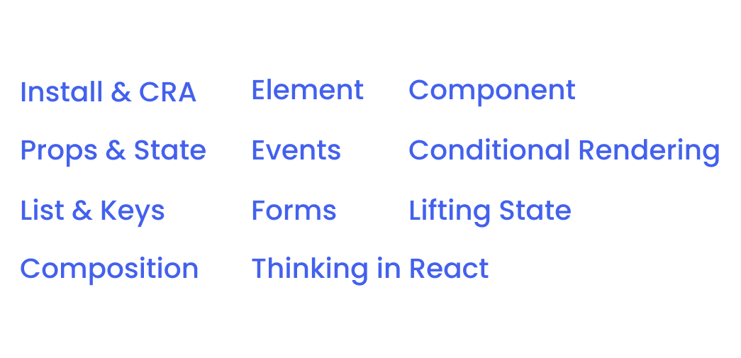
# React

Slide 23
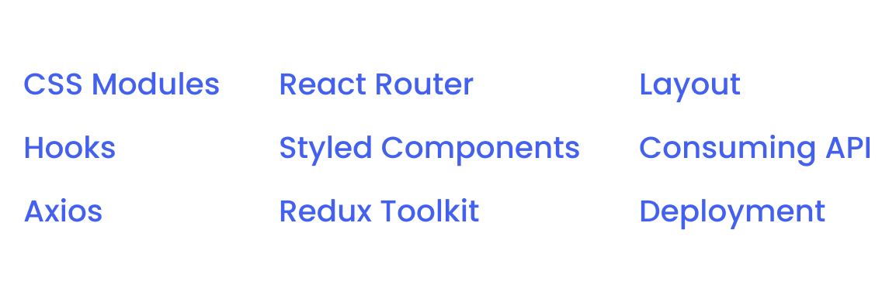
# Ecosystem

Slide 24
Congrats
We’re Frontend Engineer

Slide 25
Next Journey

Slide 26
# Next Journey
Advanced Concept: React Docs
Typescript: Freecodecamp - Typescript
Hooks:
useContext: React useContext
useReducer: React useReducer
React Framework - Next.js: Freecodecamp - Next.js
Testing:
Unit Test: Jest Docs
Component Test - React Testing Library: Freecodecamp - React Testing
Build project more and more.

Slide 27
QnA

Slide 28
Take Away

Slide 29
# TODO
Fix warnings and errors.
Deploy to Vercel and Github Pages.
Submit Vercel and Github Pages link.
Just 2 days.

Slide 30
# Assignment
Push code to Repository Github (use branch for task management).
No zip and don’t push node_nodules folder.
Submit link repository to elena.
Kamis: 18 Juni 2022, Link Elena.
Jumat: 20 Juni 2022, Link Elena.

Slide 31
Attendance

Slide 32
Thanks

